Slide 1

Initial Exploring & Modelling
for VirtualCare Volumes Forecast
DHPO210
Group 5
Group 5: 02/10/2023

Slide 2

Contents
00
Introduction
01
Initial Inspection
02
Exploratory Data Analysis
03
Preparation
04
Initial Forecast
05
Discussion

Slide 3
00
Introduction
Problem Statement
Proposal
Time frame

Slide 4

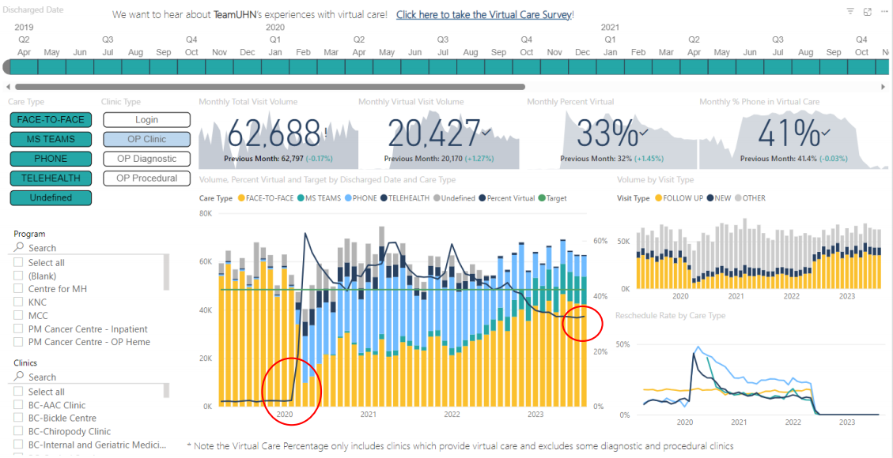
Problem Statements
Project Goal 1: Project Future Virtual Care Volumes
Based on past proportion of virtual care and the introduction of the new PSA (Physician Services Agreement), what is the projected future volume of virtual visits and what is the ideal Virtual Care Target?
Reason for Action:
•Overall virtual care Is declining based on PSA changes, post-pandemic activity levels, and preferences of patients and providers
•Anecdotally, further decline is expected

Slide 5
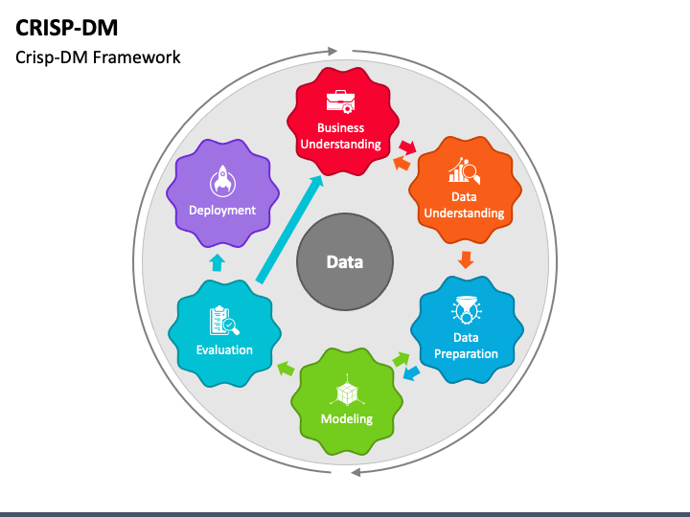
Proposal
Problem Identification
- Time-series data analysis
- Event (covid-19/PSA) capture/effect analysis
=> Solution proposed
- Focus on Time-series signal processing
- Modelling w/ specific domain knowledge
- Implementation w/ CRISP-DM
=> Outcome delivered
- VirtualCare Forecasting / Alarming
- Applied to relevant domains

Slide 6
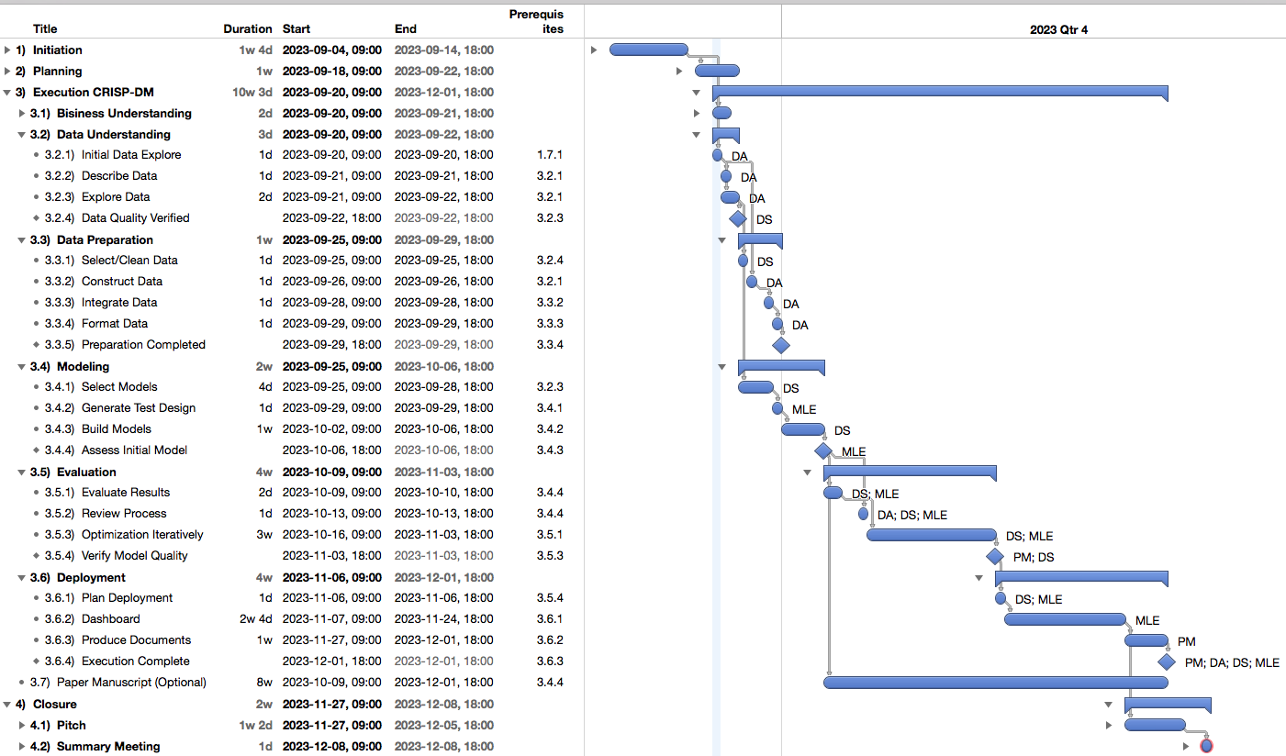
Time Frame - Here we are

Slide 7
01
Data Preprocessing
Merge Datasets
Column Inspection
Transform (Continous/Category)

Slide 8
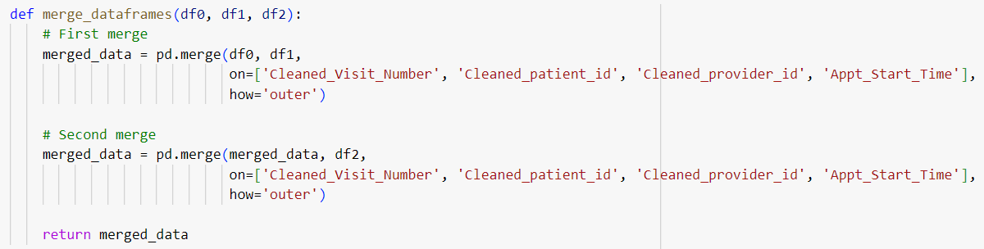
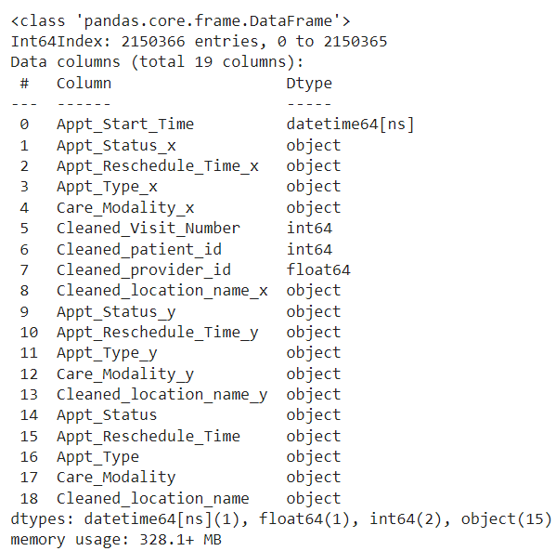
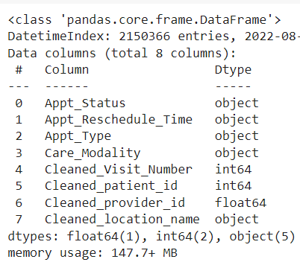
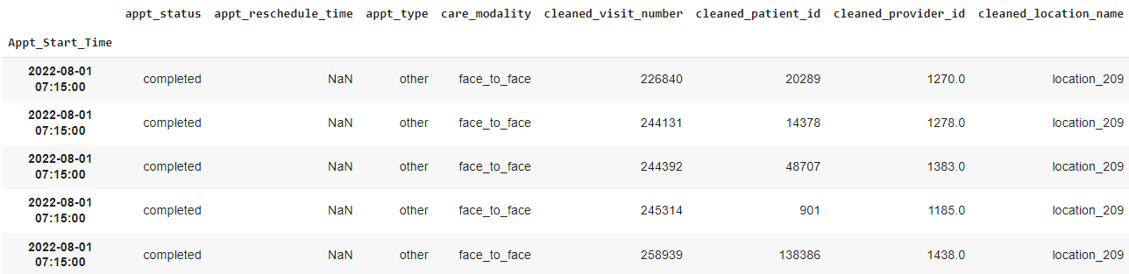
Dataset Inspection (Jupyter NB)
Dataset Merged
- 3 datasets
- Grooming
Column Inspection
- Case sensetive in Python: lower case, “_”
- 8 columns + 1 index (Timestamp)

Slide 9
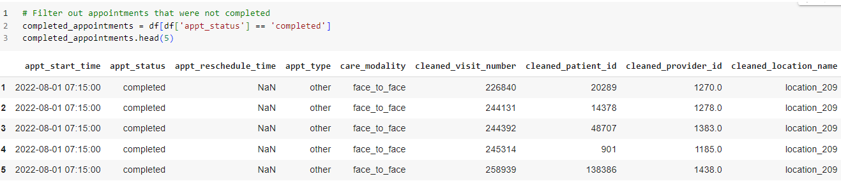
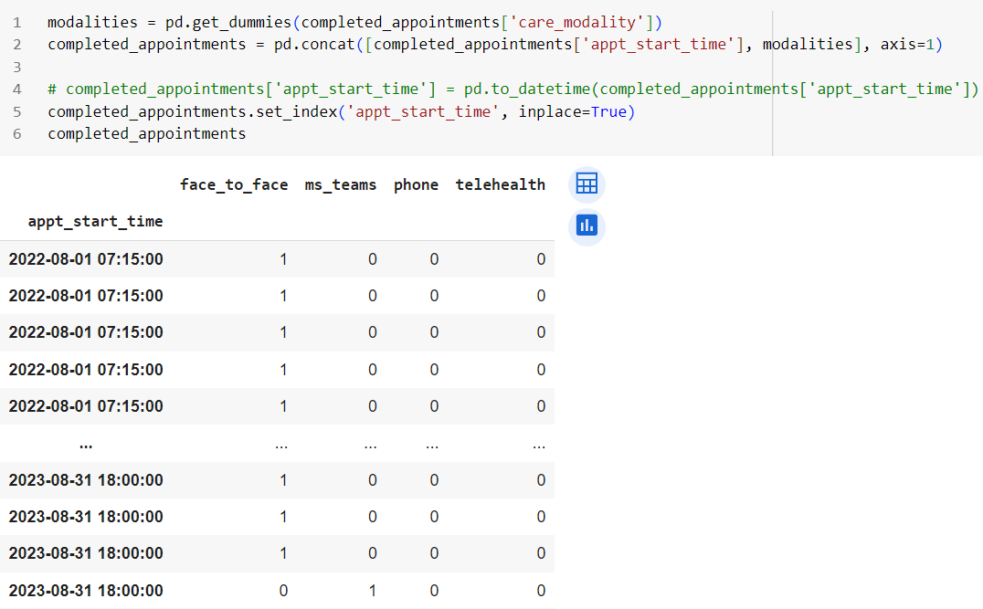
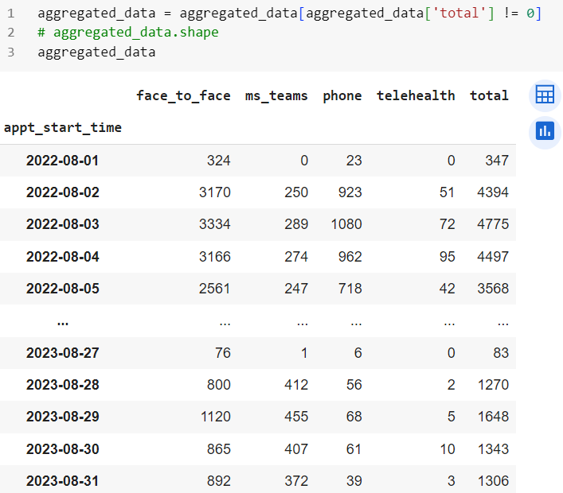
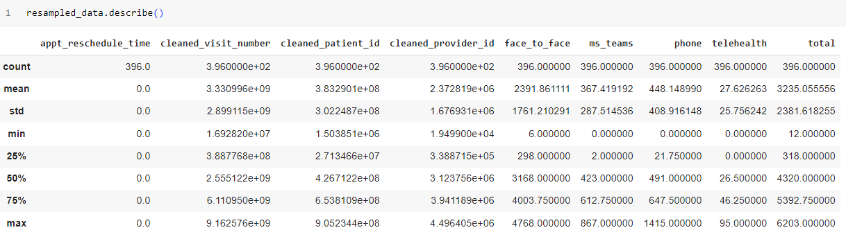
Data Transform
- Valid status (completed) - > One-Hot (categorical) -> Counts -> Stats

Slide 10
02
Exploratory Data Analysis
Careloads (Patients)
Workloads (Providers)
Locations

Slide 11
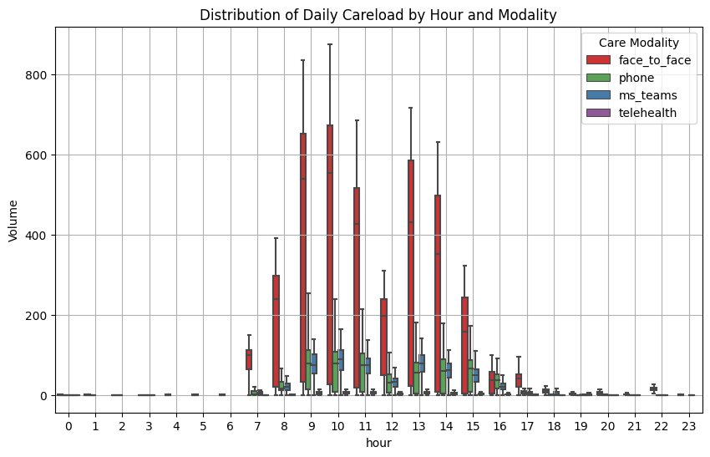
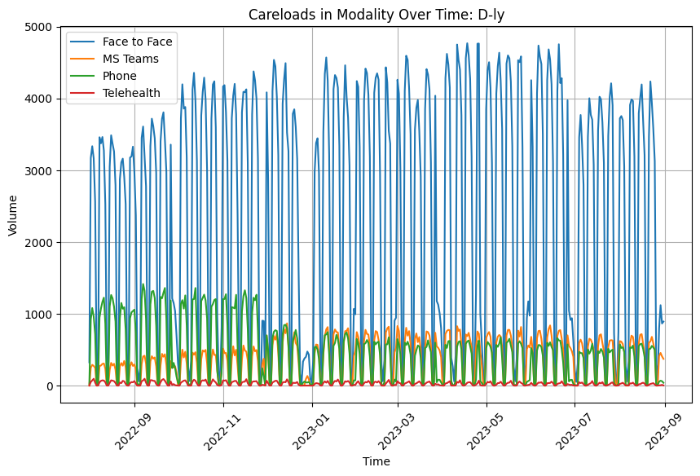
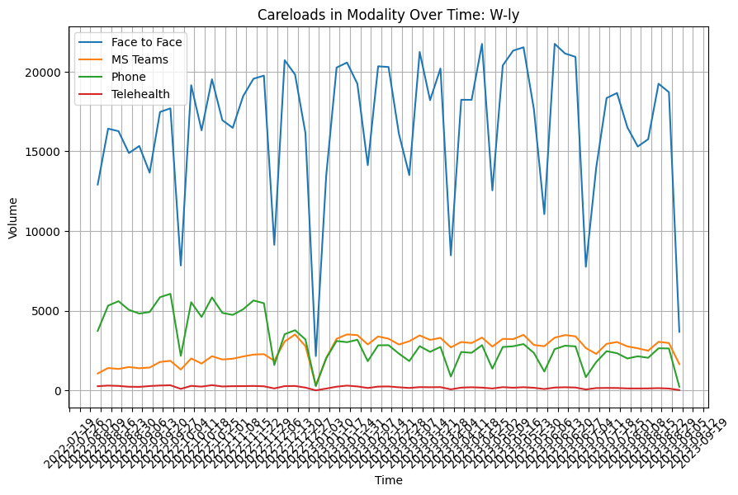
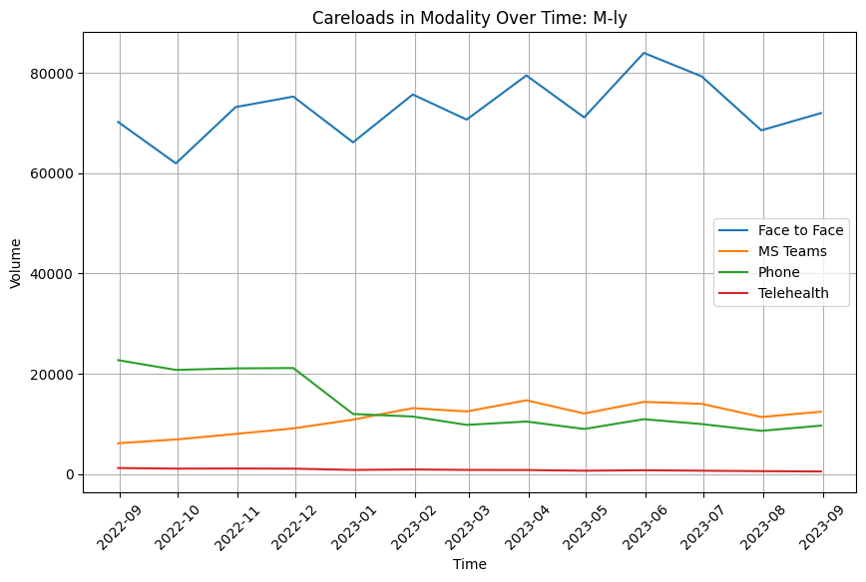
EDA - Careloads (Patients)
- The distribution of timestamps is discontinuous within one day.
=> '15T' timestamp (every 15 minutes) is not suitable for our analysis
- Overall care volumes have periodic pattern and VC volumes is deceased
=> This should be proved by advanced methods
- There are outliers (some lower values) make the curve complex
=> If retained, it will increase the model complexity

Slide 12
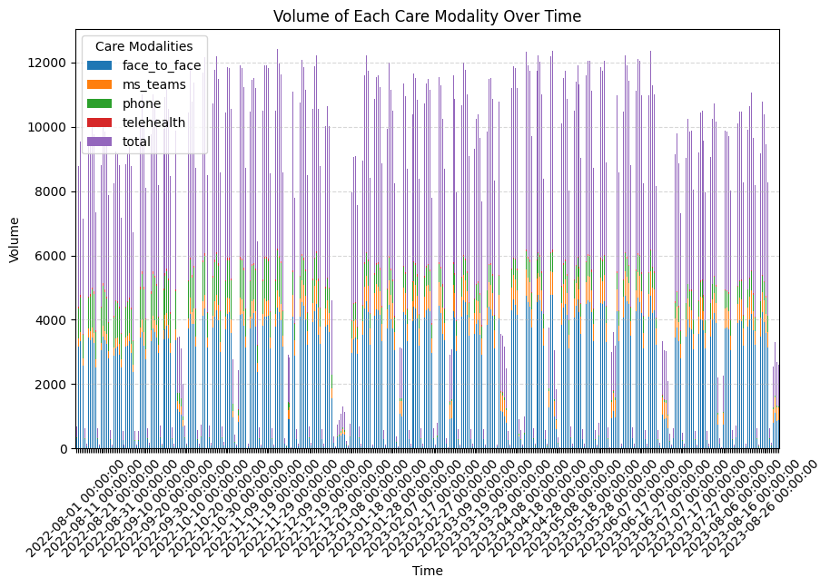
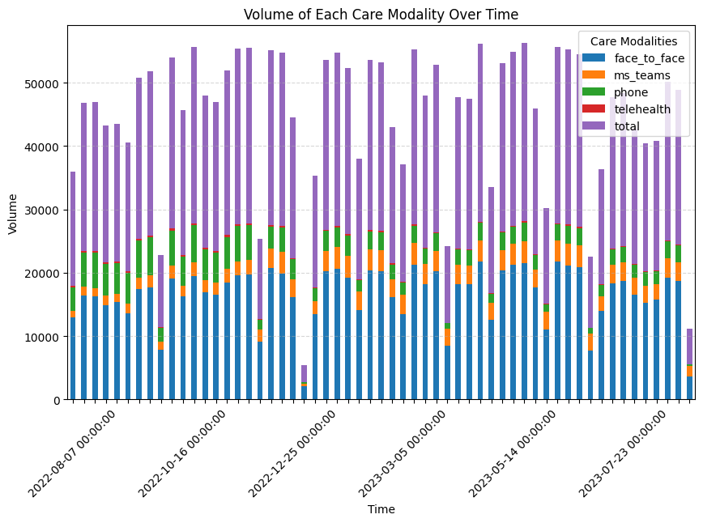
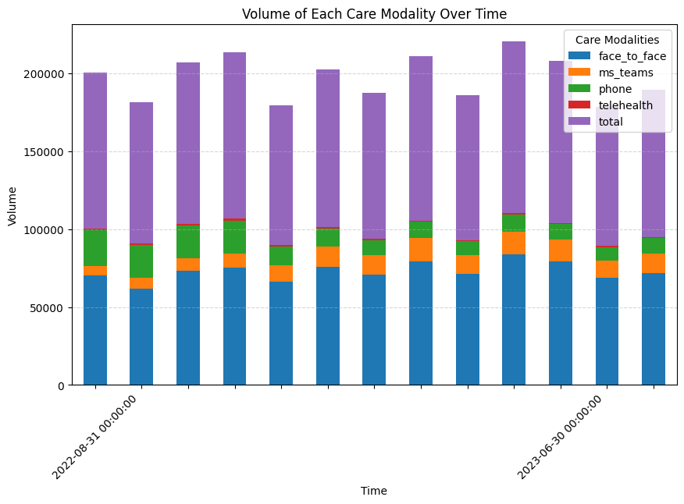
EDA - Careloads (Barplot)
- Low percentage of virtual care
=> Normalization
=> Analysis separately

Slide 13
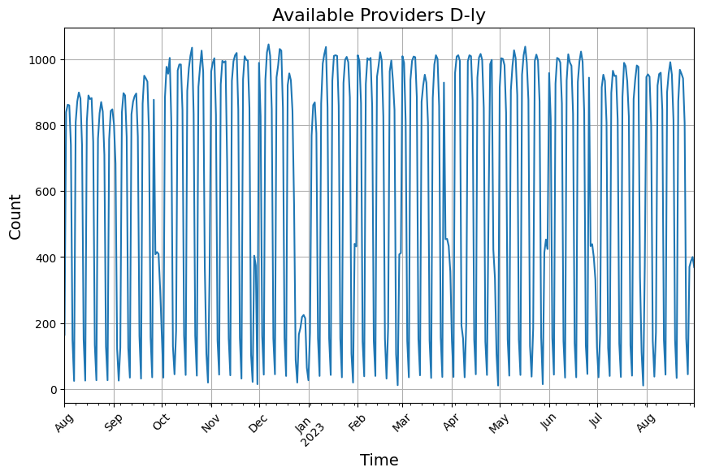
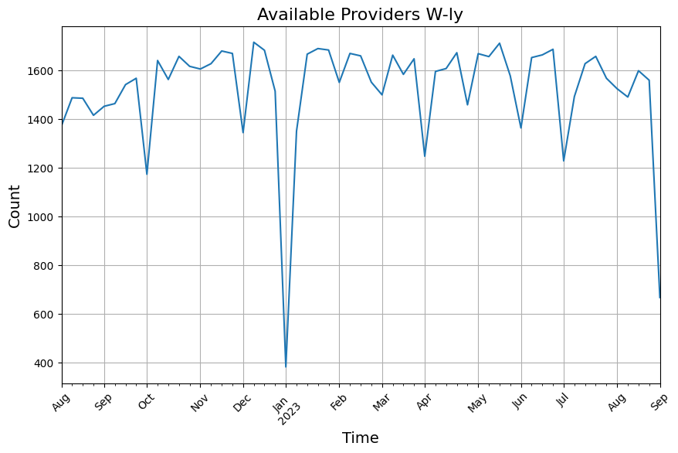
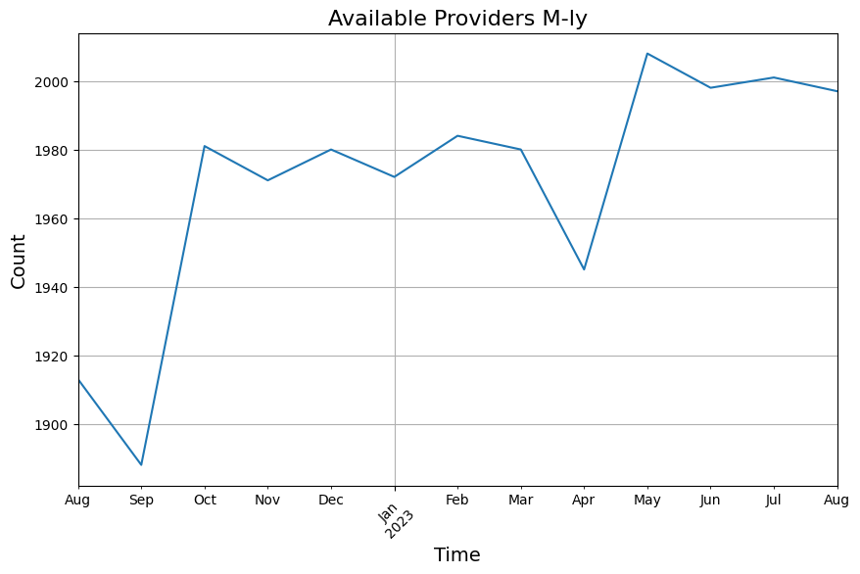
EDA - Workloads (Providers)
- The number of care providers on duty is highly consistent with the careload volume
=> This feature can be synergistically used with PSA data.

Slide 14
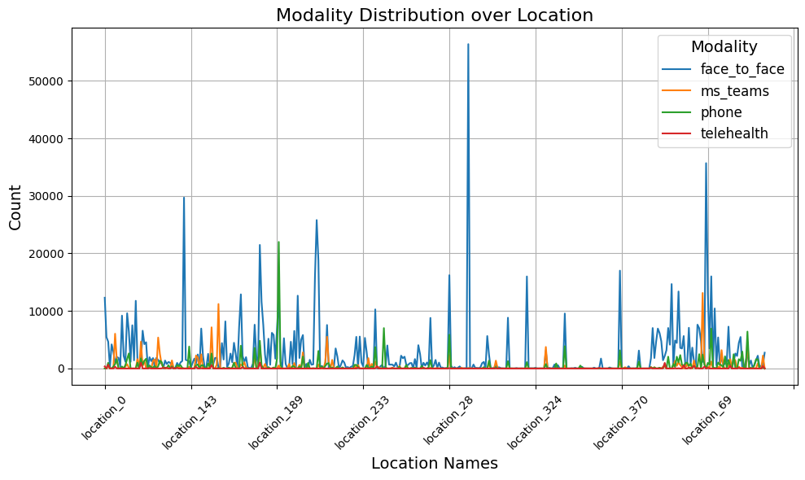
EDA - Locations
No significant insights derived from location data.”

Slide 15
03
Preparation
Preprocessing
Feature Engineering

Slide 16
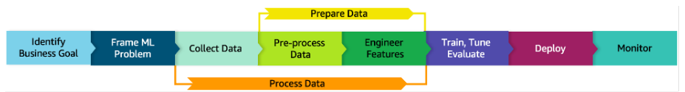
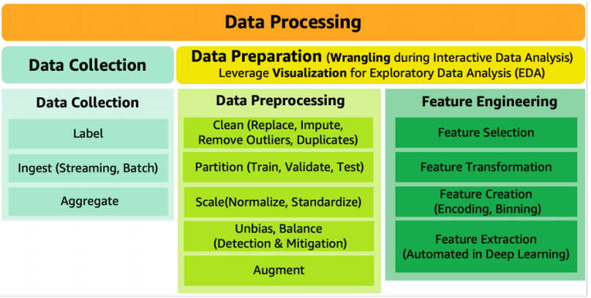
Prepossessing
- Partition (Train:Valid:Test = 6:2:2)
- Post-feature engineering normalization using Min-max scaling.

Slide 17
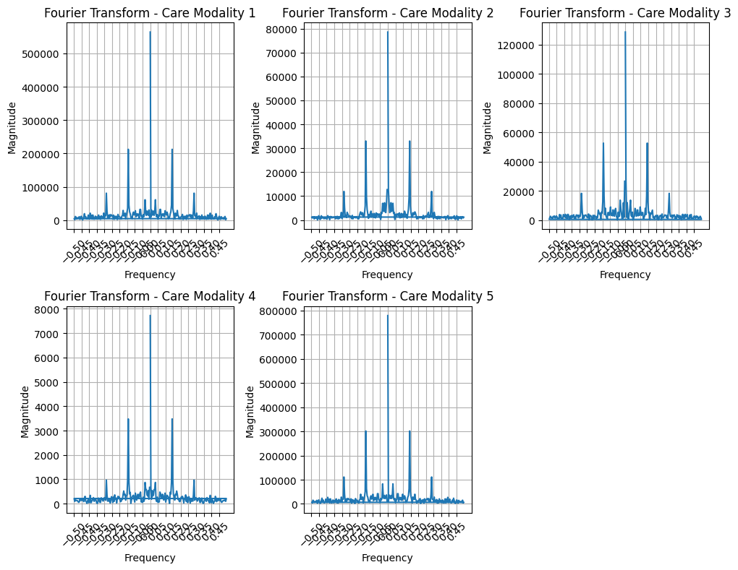
Feature Analysis - FFT
Fast Fourier Transform -1) Face2Face 2) MS_Teams3) Phone 4) Telehealth 5) Total
- Periodic patterns identified (where at when?) => JTF analysis

Slide 18
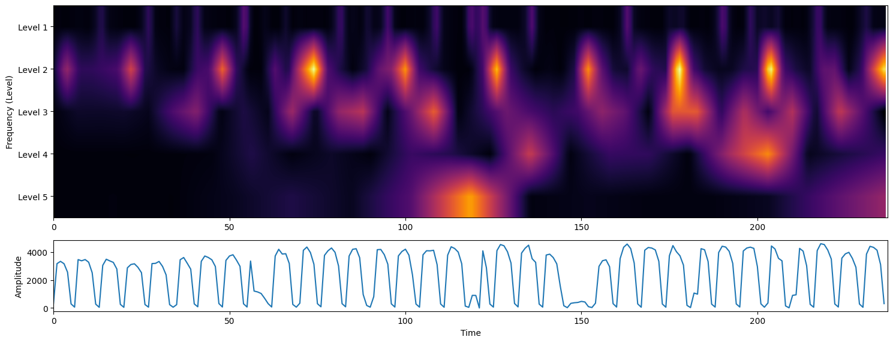
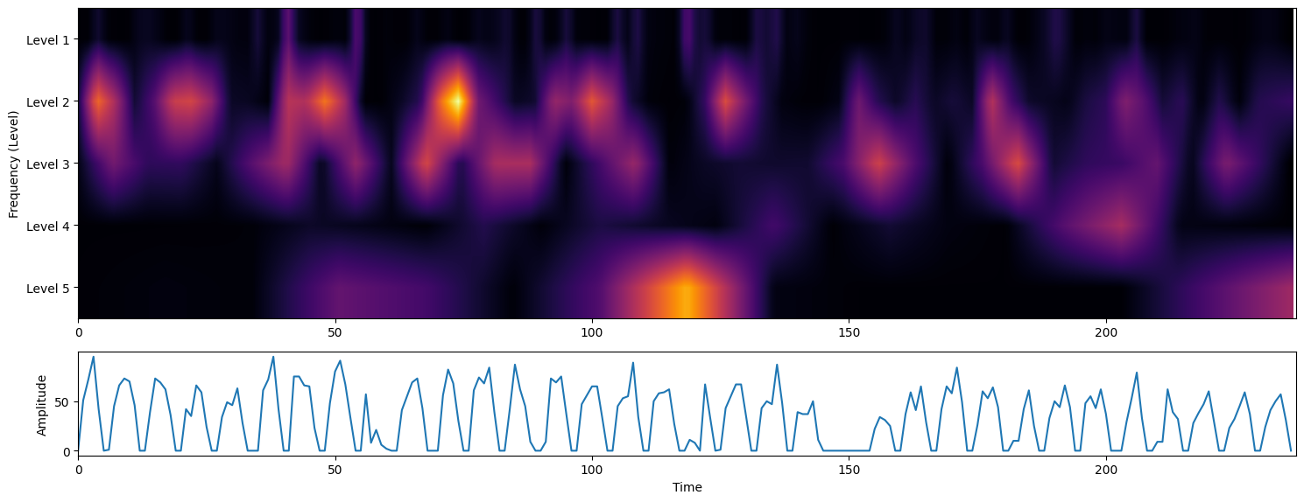
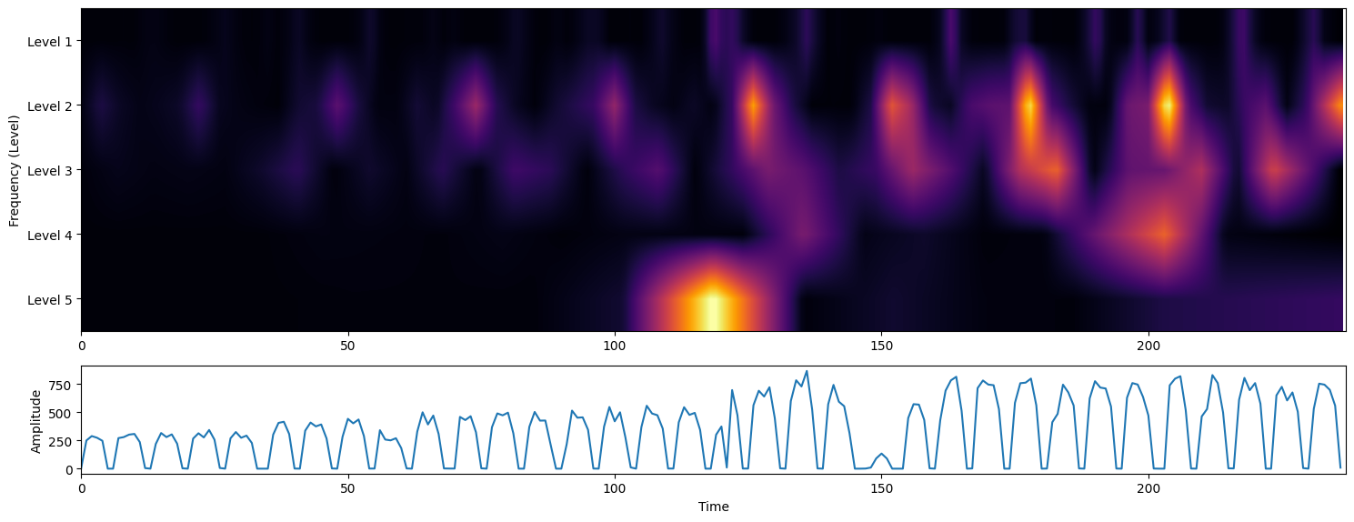
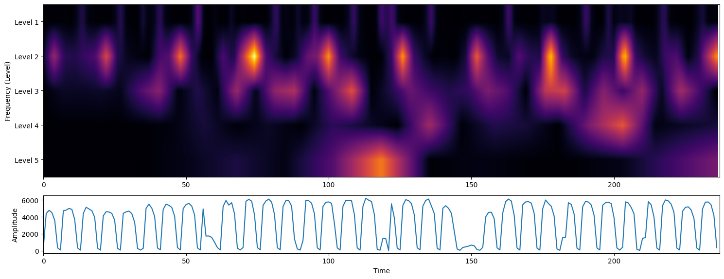
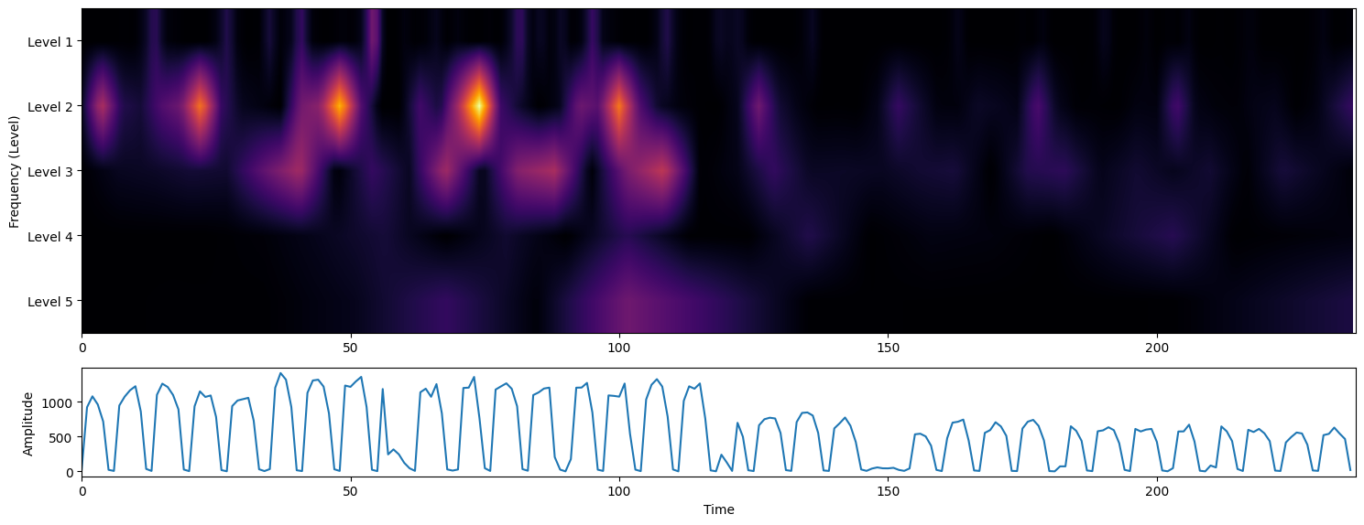
Feature Analysis - Joint Time-Frequency Analysis (WPS)
Wavelet Power Spectrum - DWT (CWT), Periodic patterns@Level 2 or 3

Slide 19
Feature Engineering - COVID-19/PSA
Events (planning) - Introduce Covid19/PSA (Physician Service Agreement)
- Categorical data: One-Hot Encoding for Covid-19 or Dates of PSA execution
- Sequential data : additional CWT Scalogram for event capture

Slide 20
04
Initial Forecast
Statistical Models (ARIMA)
RNN Models (LSTM)

Slide 21
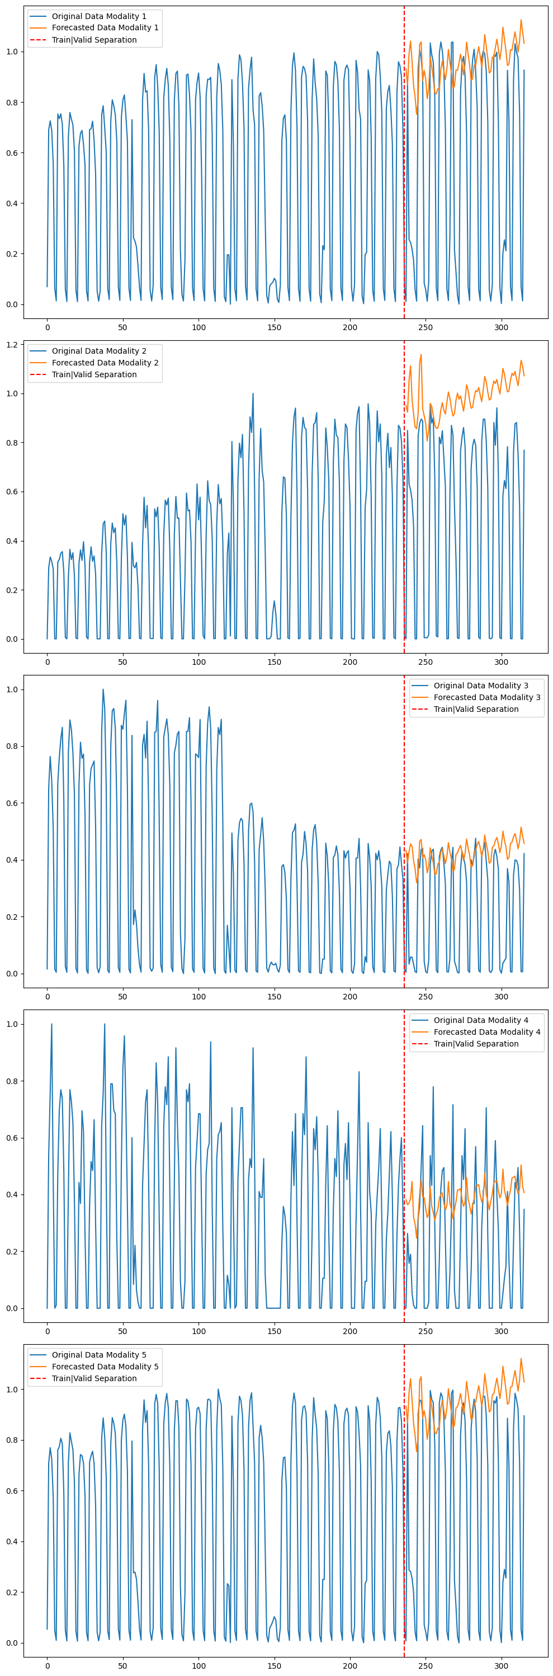
Statistical Model
Modes - ARIMA: Forecasting Performance Metric: RMSE. The model did not capture significant patterns, resulting in a high RMSE.

Slide 22
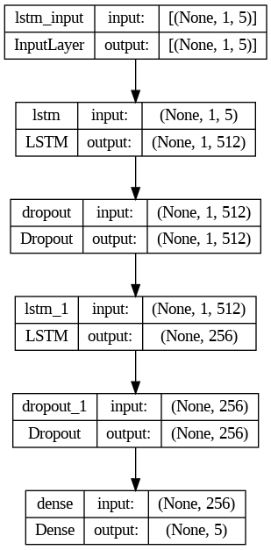
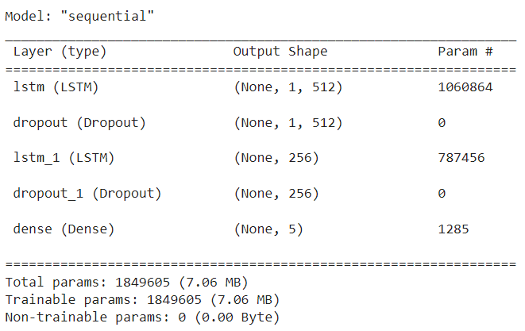
Long Short-Term Memory Networks - Model
Model Hyper-parameters (Using TensorFlow Framework):
- learning_rate(Adam) = 0.0001, epochs=200, look-back=1, batch_size=2
- Criteria (Loss: RMSE)
Model Structure

Slide 23
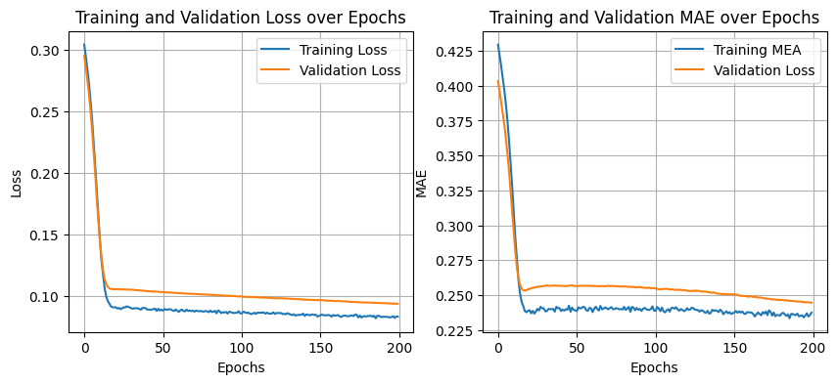
LSTM - Training/Validation Performance
Training/Validation
- 4 modalities + Total (w/o features of provider)

Slide 24
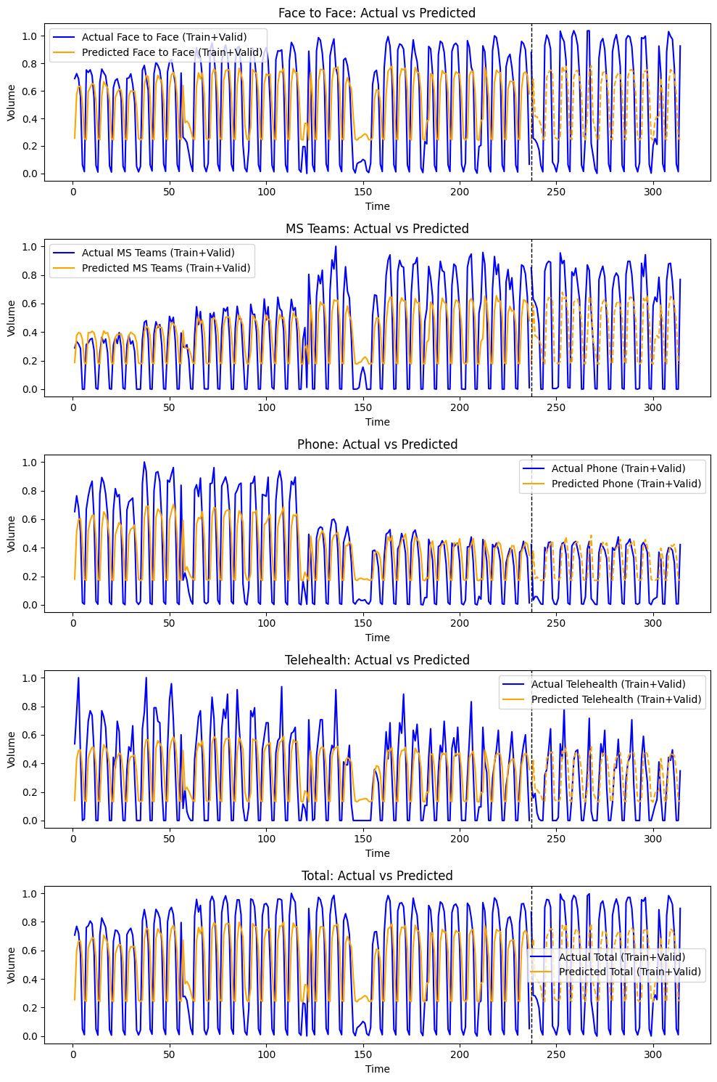
LSTM - Forecast (w/o WPS)
Training/Validation Performance - Blue/Orange solid lines (Raw); Orange dot line (Predicted)

Slide 25
05
Discussion
Limitation
Next Steps

Slide 26
Next Steps
Data
- Data of Virtual-care covering Covid-19 from VC Team
- Public datasets for Covid-19 and PSA (on going)
- More domain knowledge
Features
- Introduce Extracted WPS for LSTM (on going)
- Other features
Model Optimization
- LSTM: improve performance (RMSE) with optimized hyper-parameters (on going)
- Models: Hybrid (better for events capture)
Delivered Outcomes
- Dashboard (Power BI / Custom Webpage) ? consult from Mentor/VC team@UHN

Slide 27
THANK
YOU
Group 5

